Slide 1


MPPCs for nEXO
Fabrice Retière for EXO photo-detector group

Slide 2
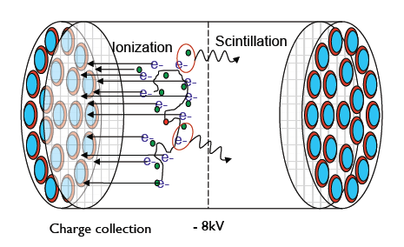
The EXO concept
Charge readout
2D position
Charge arrival time
Energy
Light readout
Timing resolution
Event start time
No need for good energy resolution
Energy

Slide 3
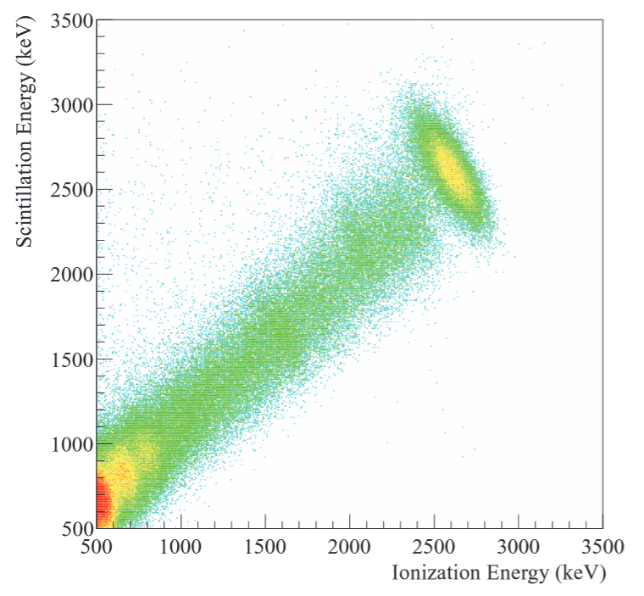
Light/charge fluctuations
Single site data with ²²⁸Th source
Critical to detect simultaneously
Ionization electrons
Scintillation photons at 175nm

Slide 4
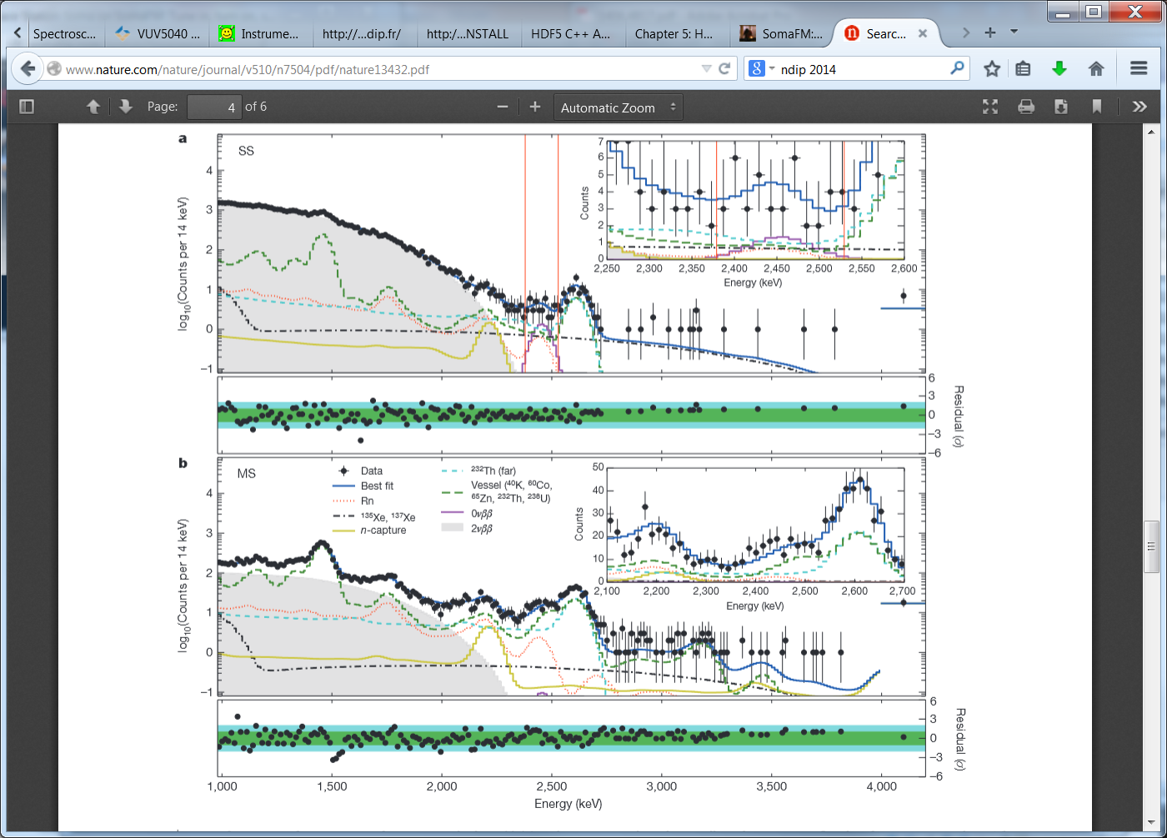
EXO-200 looking for 0νββ
Nature 510, 229–234 (12 June 2014)
Background reduction:
Energy resolution
Low radioactivity
LXe self shielding an dMulti-site / single-site (does not affect light)

Slide 5
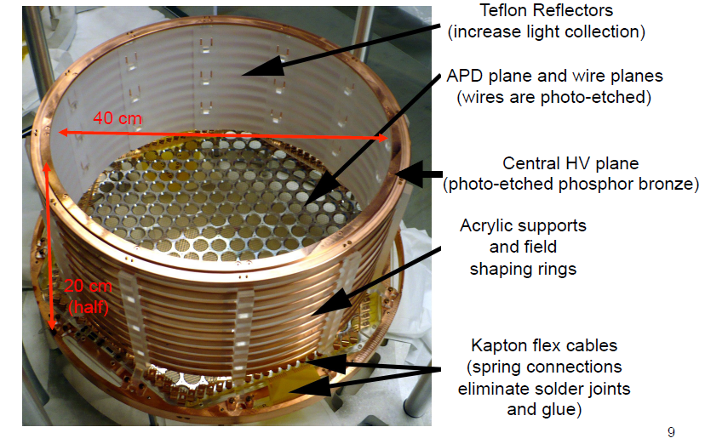
EXO-200

Slide 6
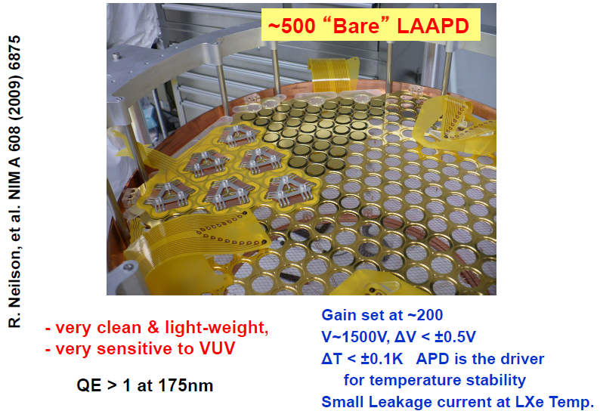
Light detection in EXO-200

Slide 7
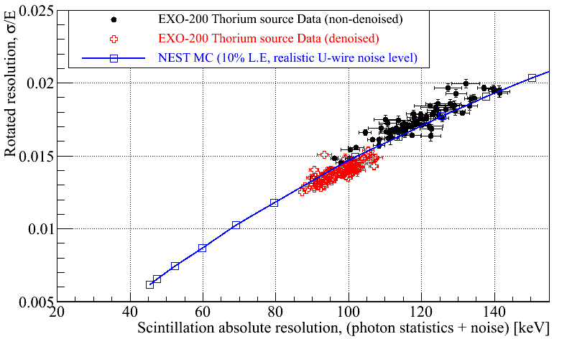
EXO-200 resolution limited by APD noise
Active area of nEXO going up by more than x10
Electronics noise is going to get much worse...
Expected APD noise after electronics upgrade
Average APD
Noise at WIPP
7

Slide 8
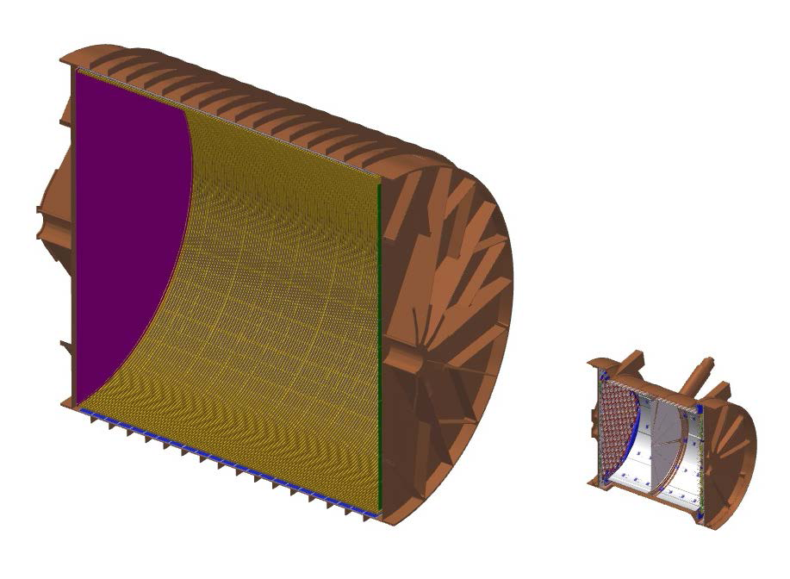
EXO-200 to nEXO
nEXO: at the conceptual stage
EXO-200 “operating” detector
Two drift regions (central cathode)
Charge collection on anode wires
Light readout by ~500 APDs

Slide 9
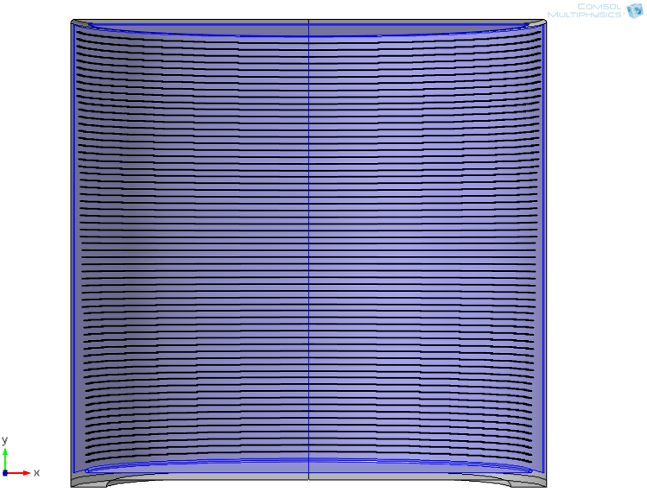
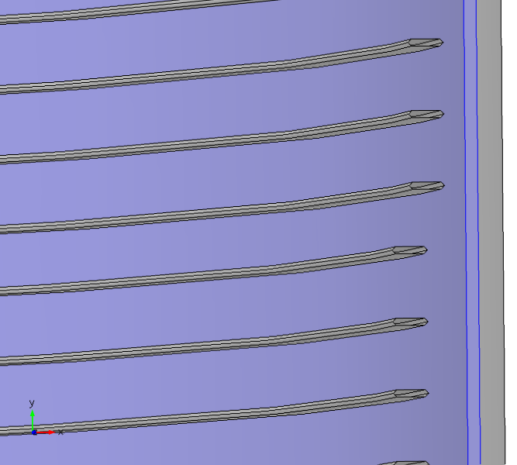
nEXO baseline configuration Up to 4 m² of photo-detectors
~130cm diameter
Field rings
Anode
~130cm long (single drift space)
Photo-detector
Vessel
Drawing by T.Tolba (Bern)
Cathode

Slide 10
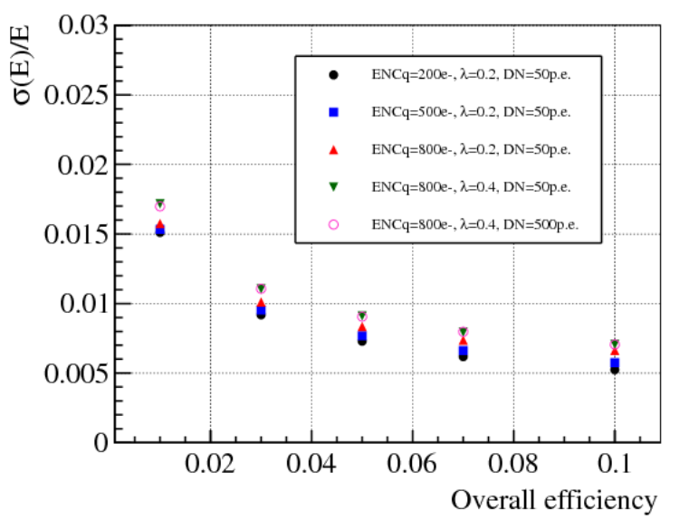
Scintillation photon detection requirements for nEXO
ENCq= electronics noise on charge
λ = correlated avalanche (AP+CT)
DN = dark noise rate
Neglect light electronics noise
Work led by G.Cao (IHEP)

Slide 11
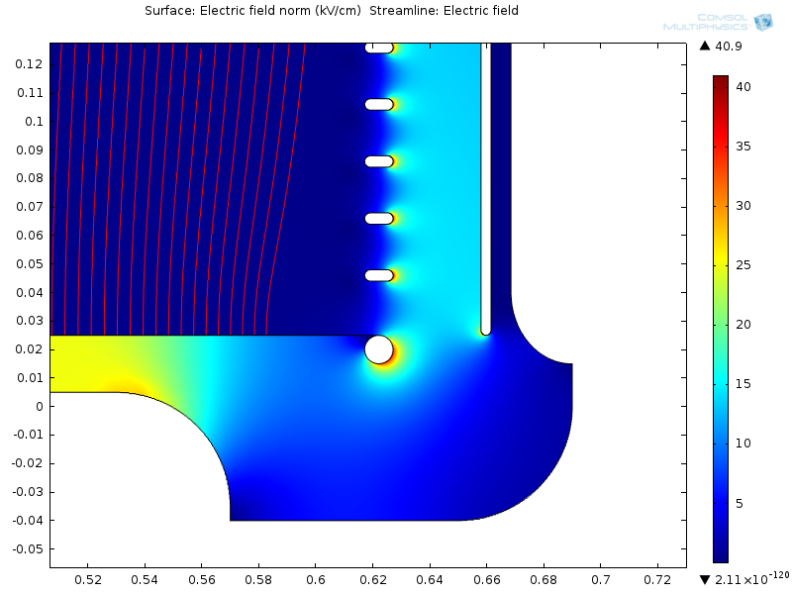
Side issues about E-Field Charge may land on MPPCs
Photo-detectors
Shaping ring
Cathode (bulge)

Slide 12
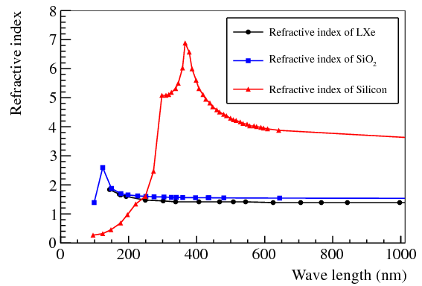
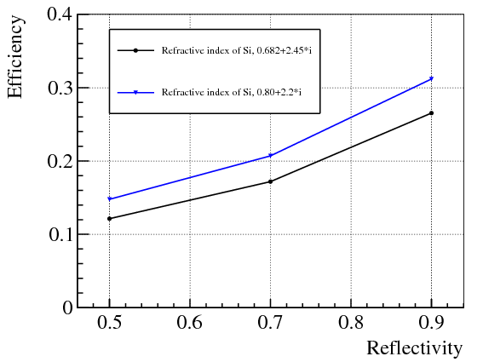
Aside about index of refraction
n_{LXe} ~ n_{SiO2} ~ 1.7
Re(n_{Si}) ~ 0.7-0.8
Surprisingly large uncertainty
Very significant reflections at Lxe/SiO2-Si
Anti-reflective coating with MgF2?
Reflected photons have a fair chance of being detected later on
Account for reflectivity in simulations
Need careful scaling from measurements in gas/vacuum
http://refractiveindex.info/
http://www.ioffe.ru/SVA/NSM/Semicond/Si/optic.html

Slide 13
Photo-detector specifications for nEXO
Parameters | Value
Photo-detection efficiency at 175-178nm (without AR coating measured in gas/vacuum) | ≥15%
Radiopurity: contribution of photo-detectors to the overall background | <1%
Dark noise rate at -100°C | ≤50Hz/mm²
Average number of correlated avalanches per parent avalanche at -100°C | ≤0.2
Single photo-detector active area | ≥1cm²
Capacitance | <50pF/mm²

Slide 14
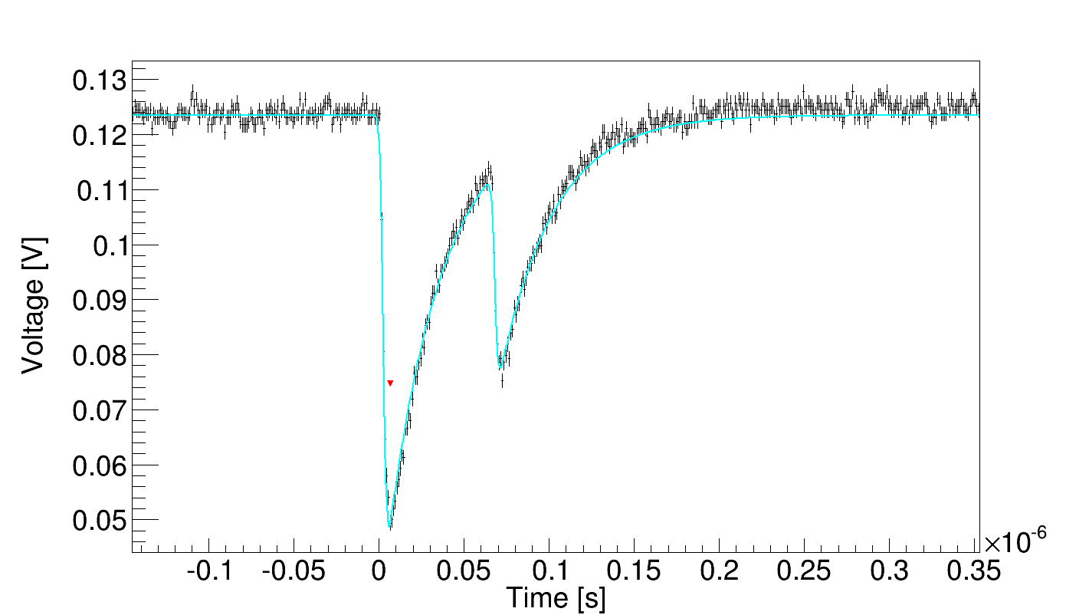
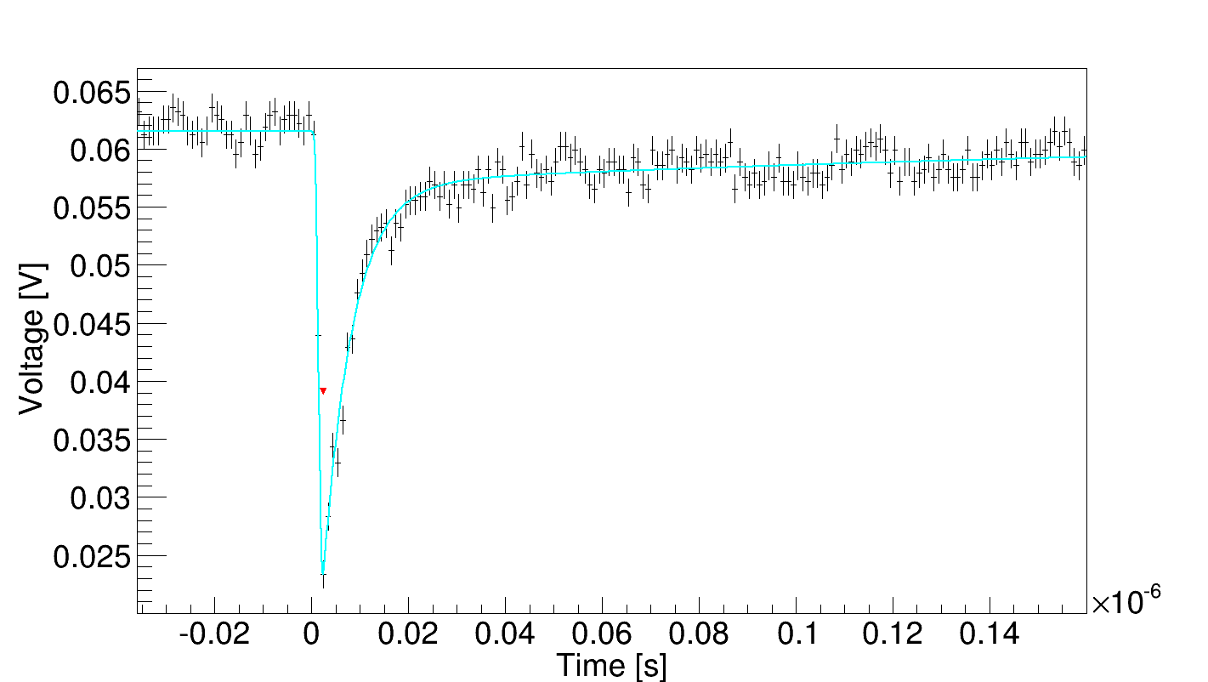
Assessing nuisance parameters TRIUMF test setup
Control temperature down to -110C
Trigger on dark noise pulses with threshold ~0.5PE
Measure cross-talk as
P1 = 1-N1/Ntrig
N1 = number of single PE
Measure all pulses following trigger
Fit when pulses are close to each others
Use scope time for late pules
Built time difference distribution between trigger and next pulse

Slide 15
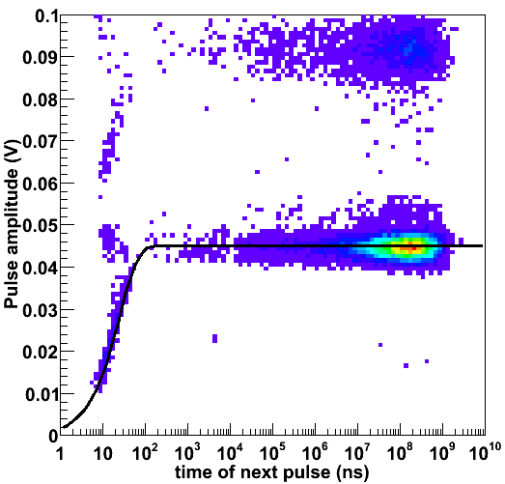
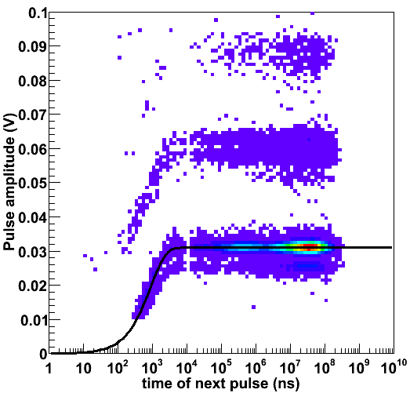
Amplitude and time after an avalanche
Cross-talk
KETEK
Still a bit of hole diffusion?
25ns recovery
900ns recovery

Slide 16
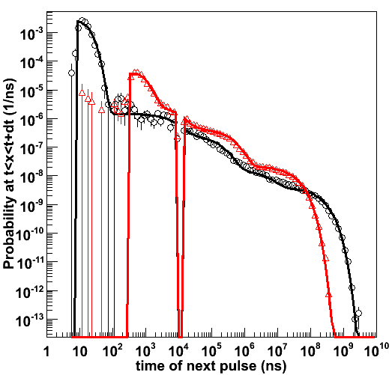
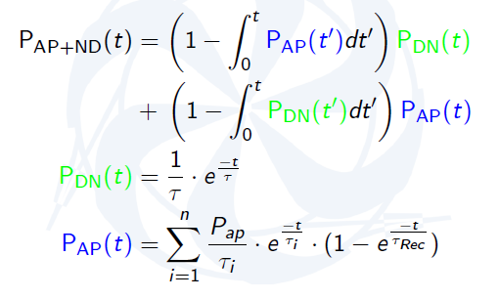
Timing analysis at -100°C
Hamamatsu
KETEK
Improve this plot
Poor fit.
Not exponential
Dark noise edge yields ~0.5Hz/mm2
But some not so clear issue with long
time constants
Short AP time constant ~2% probability
Scope dead time
Dark noise edge
Add recovery plot

Slide 17
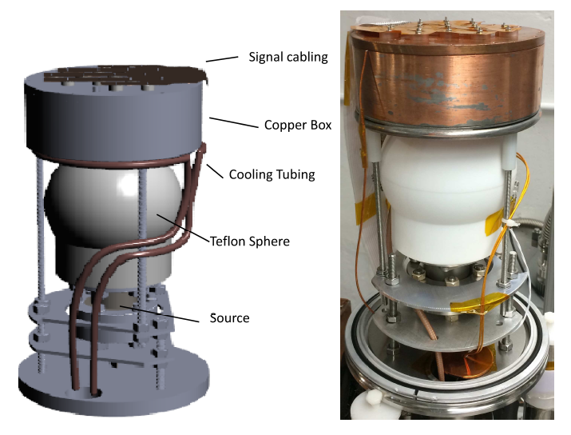
Efficiency measurement at Stanford
In vaccum
Light source: Xe gas scintillation
Liquid nitrogen cooler
Use reference Rxxx PMT for light yield calibration

Slide 18
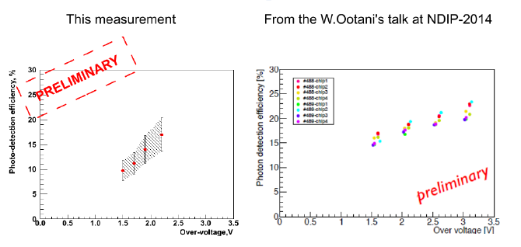
Efficiency measurement at Stanford

Slide 19
Low radioactivity issue
Hoping to have the photo-detectors contribute less than 1% of total background
²³⁸U and ²³²Th are <9mBq/kg (<0.73pg/g) and <43mBq/kg (<10pg/g)
Impossible to measure by counting: 1kg of material yield 1 count in 30h.
Assaying either by neutron activation in a reactor or Inductively Coupled Plasma Mass spectrometry
Measure content of stable isotopes and assume equilibrium
Assaying must happen in parallel with device characterization
Low radioactivity packaging: looking at bounding Silicon chip on quartz plates

Slide 20
Low radioactivity packaging
nEXO requirements are extremely low
Much lower than dark matter experiments
Strategy:
Use as little material as possible
E.g. Mount MPPCs directly on Photo-detector Readout Board. I.e. Without carrier board. Make testing very cumbersome however
Assay every single pieces of material
EXO would like to assay raw materials (e.g wire bound, epoxy) before they get used in the final product
Assay a sample of silicon before packaging
Use Nuclear Activation for Enhanced sensitivity

Slide 21
Low radioactivity material
Silicon is expected to be fine
Though, may depend on details...
Wire bound. Little material. Probably ok
Epoxy. Little material. Probably ok
Some Epoxies were found to be acceptable in EXO-200
Electrically conductive epoxies have not be tested though
Also possible issue with contamination of the liquid Xenon
Carrier board material. Significant amount of material (more than Silicon) so risky
EXO currently investigating using quark or Saphire
Metal for electrical connection
Some copper has very low radioactivity. Can be provided by nEXO
Solder for board to board connections
Can be very radioactive and should be avoided as much as possible
Other possible materials: optical thin films, window in front of the MPPC will have to be assayed

Slide 22
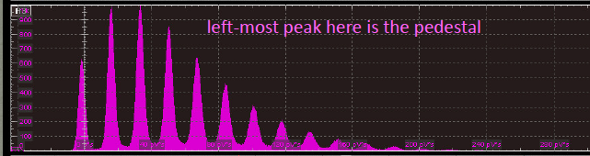
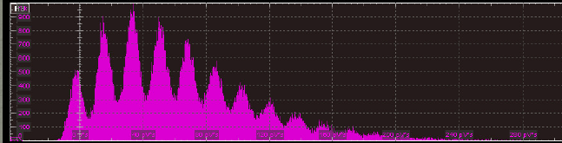
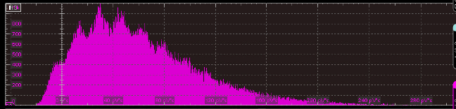
Large area readout issues
G. Visser
PD area~4m2
# channel~ 100-10,000
Channel area up to 20×20cm²
Common base option may work
Single photon identification compromise with >10nF
Total power < 50W
MPPC
3x3 mm²
0.32 nF
MPPC
3x3 mm² + 6.6 nF
~1.4×1.4cm²
MPPC
3x3 mm² + 15 nF
~2×2cm²
G. Visser (Indiana U.)

Slide 23
Possible readout configuration
Photo-detectors
2×2cm²
Carrier card
Holding photo-detector
May not be needed
2.2×2.2cm²
Support and connection board
16 readout ASICs on the back side
All connections on the back side
Photo-detectors
ASIC
Support and
Connection
board
Carrier cards

Slide 24
Possible configuration 2
PRB photo-detector side
16 ASICs per photo-detector readout boards (PRB)
1 coincidence unit per PRB and possibly ADC and timing capabilities
Would require ~24 PRBs
x2 segmentation in z
x12 in azimuth
Total number of photo-detectors
~70cm
Note that the numbers don’t fully add-up accounting
for nEXO’s current baseline geometry. But it does not
matter right now.
~35cm

Slide 25
MPPC configuration
Area requirement 4 to 5 cm²
Based on 3x3 mm2 devices
8x8 matrix = 2.4x2.4 = 5.76 cm² (need ~10,000 in that case)
7x7 matrix = 2.1x2.1 = 4.41 cm²
6x6 matrix = 1.8x1.8 = 3.24 cm²
Or possibly on different sizes
Desirable to connect all the MPPCs on the silicon to minimize connections
The question is whether or not to have some MPPCs in series vs parallel
One option: 4x4 matrix of 6x6mm2 (or 8x8 of 3x3mm2) making 4 groups of MPPCs connected in parallel (either 4 6x6mm2 or 16 3x3mm2) and then connect the 4 groups in series
Or for better uniformity connect first in series 4 6x6 mm2 (or 16 3x3mm2) and then connect in parallel.

Slide 26
Using MEG MPPC for development
Investigate series vs parallel solution using MEG MPPCs at TRIUMF
PCB holding the MPPC must fit on the cold chuck
Cold board
1 MEG MPPC
Test performances with
16 6x6mm2 in parallel
4 6x6mm2 in series then parallel
4 6x6mm2 in parallel then series
Analog board
Schematics: L. Fabris, ORNL
Layout: M. Constalbles, TRIUMF?
Cold board
4 MEG MPPCs
Analog board
Schematics: L. Fabris, ORNL
Layout: M. Constalbles, TRIUMF?
Test performances with
1 6x6mm2
4 6x6mm2 in series
4 6x6mm2 in parallel

Slide 27
The current landscape
Parameters | Spec. | FBK-2010 | HPK | KETEK | SensL
Over-voltage | N/A | 5V | 2.5V | 2.5V
PDE at 175nm (%) | >15% | 10^{S} | 17^{S} , 19^{M} | 0 | 0
Dark noise rate at -100C (Hz/mm²) | <50 | 10³ ^{S} | 0.5^{T} | 4^{T} | ?
Cross-talk probability |  | 0.06^{S} | 0.34^{T} | 0.1^{T} | ?
Total after-pulsing rate at -100C |  | ? | 0.16^{T} | 0.25^{T} | ?
Xt+AP within 10 μs at -100C | <0.2 | ? | 0.38^{T} | 0.15^{T} | ?
Recovery time |  | ? | 25ns^{T} | 900ns^{T} | ?
Pulse rise time (Gaussian σ) |  | ? | 1.6ns^{T} | 0.5ns^{T} | ?
Pulse fall time(s) (exp. constant) |  | ? | 30ns^{T} | 6/300ns^{T} | ?
Capacitance (pF/mm²) | <50 | 330 | 35 | 100 | 80 / 3.2
Thorium content (μBq/kg) | < 43 | <13 ^{A} | <42 10³ | ? | <2 10⁶ ^{N}
Uranium content (μBq/kg) | < 9 | <2.5 10^{2 A} | <100 10³ | ? | <94 10⁶ ^{N}
Potassium content (μBq/kg) | ? | <1.4 10^{2 A} | <43 10³ | ? | <4.7 10⁶ ^{N}
^{S} Measured at Stanford, ^{T} Measured at TRIUMF, ^{A} measured at U.Alabama with neutron activation
^{M} Measured by the MEG collaboration, ^{N} measured by the NEXT collaboration by Ge counting

Slide 28
Summary
Hamamatsu MPPCs are very well suited for nEXO if 2 issues can be addressed
Lower cross-talk with trenches. Easy?
Find a way to achieve the required extremely low radioactivity... Hard?
Would be nice add-ons:
Increase efficiency using anti-reflective coating. Possible?
Lower capacitance per unit area. Possible?

Slide 29
Time scale
Identify compelling photo-detector(s) by the end of 2016
Build a small scale (10x10x10cm3) demonstrator by early 2017
Down-select by DOE in 2016 or 2017
Chose technology, i.e. Germanium or Xenon
Construction starting in 2017 or 2018

Slide 30
Add-on

Slide 31
Low capacitance SiPM concept
Motivations
Lower electronics noise. Can live with lower gain
Less gain: reduce correlated avalanche rate
Maintain same peak current which to first order is defined by ΔV/R_{quench}. Peak current is critical for good timing
Narrow pulse. Fall time ~ R_{quench} x Cpix
Idea
“Point” contact diode
Need electric field to drift carrier to point contact
Impact ionization only occurs close to point contact
Single carrier detection (e- prefered)
Block carriers from substrate from reaching the drift field region

Slide 32
Quenching resistor
metal
metal
SiO2
n++
High field region
p-
p-
p++
substrate

Slide 33
p-
p++

